Slide 1
You're NOT doing usability testing?
Are you…nuts?
Steve Krug MinneWebCon 2015

Slide 2
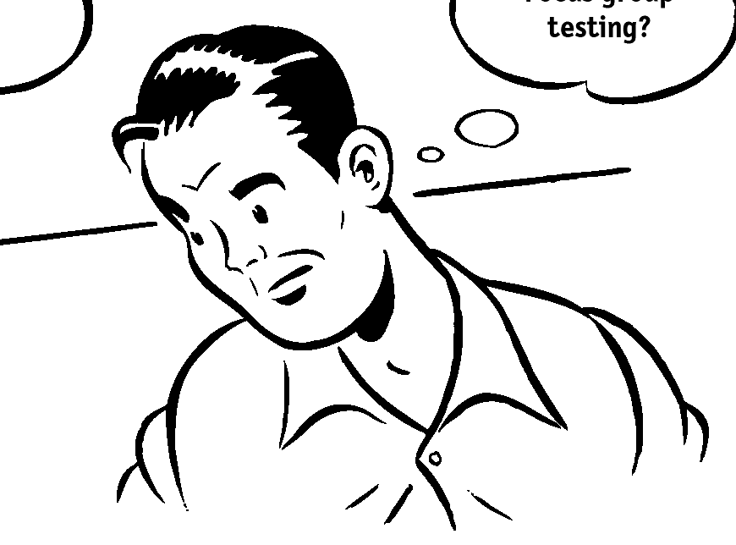
But enough about me
Steve Krug (steev kroog) (noun) 1. Son, husband, father 2. Resident of Brookline, Massachusetts 3. Usability consultant
Advanced Common Sense
Me and a few well-placed mirrors
Corporate motto: “It’s not rocket surgery™”

Slide 3
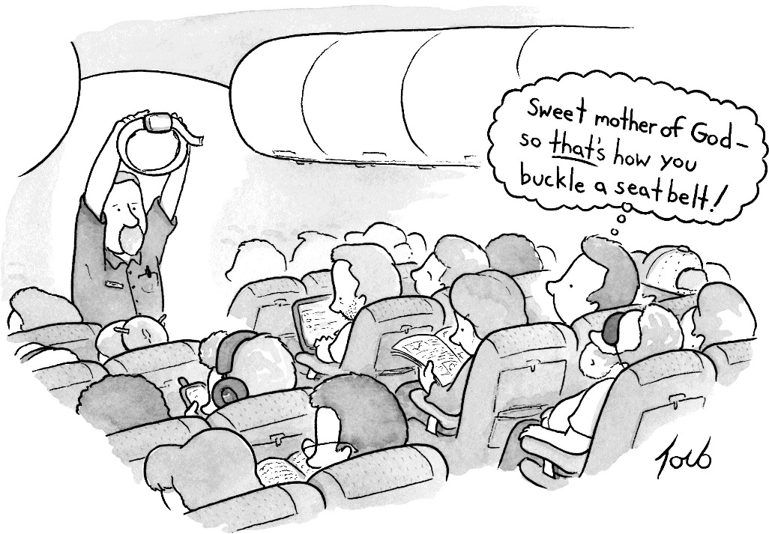

Slide 5
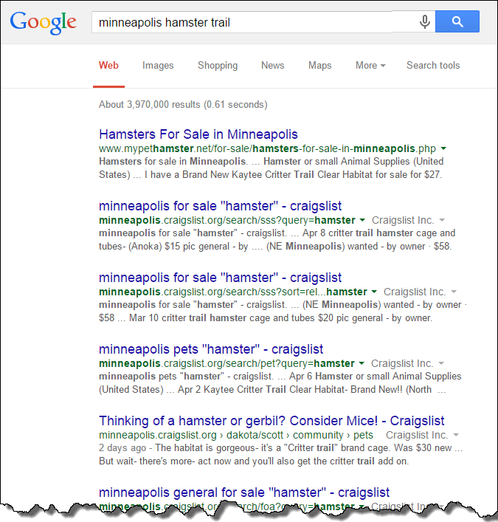

Slide 6
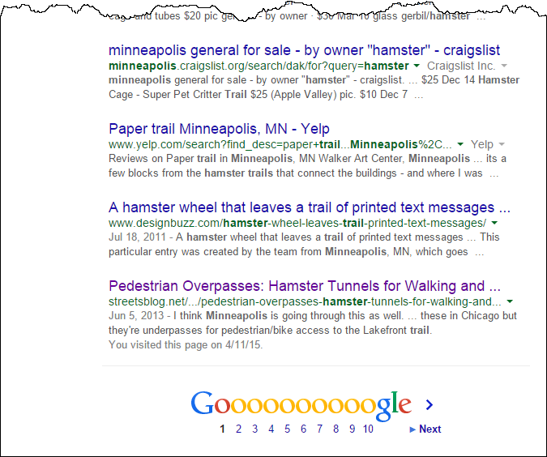

Slide 14
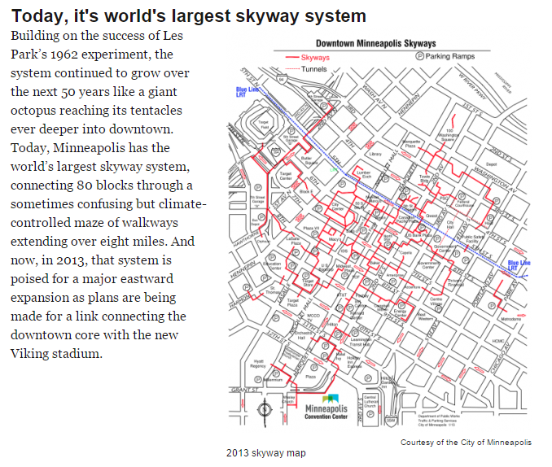
www.minnpost.com 07/03/13

Slide 15
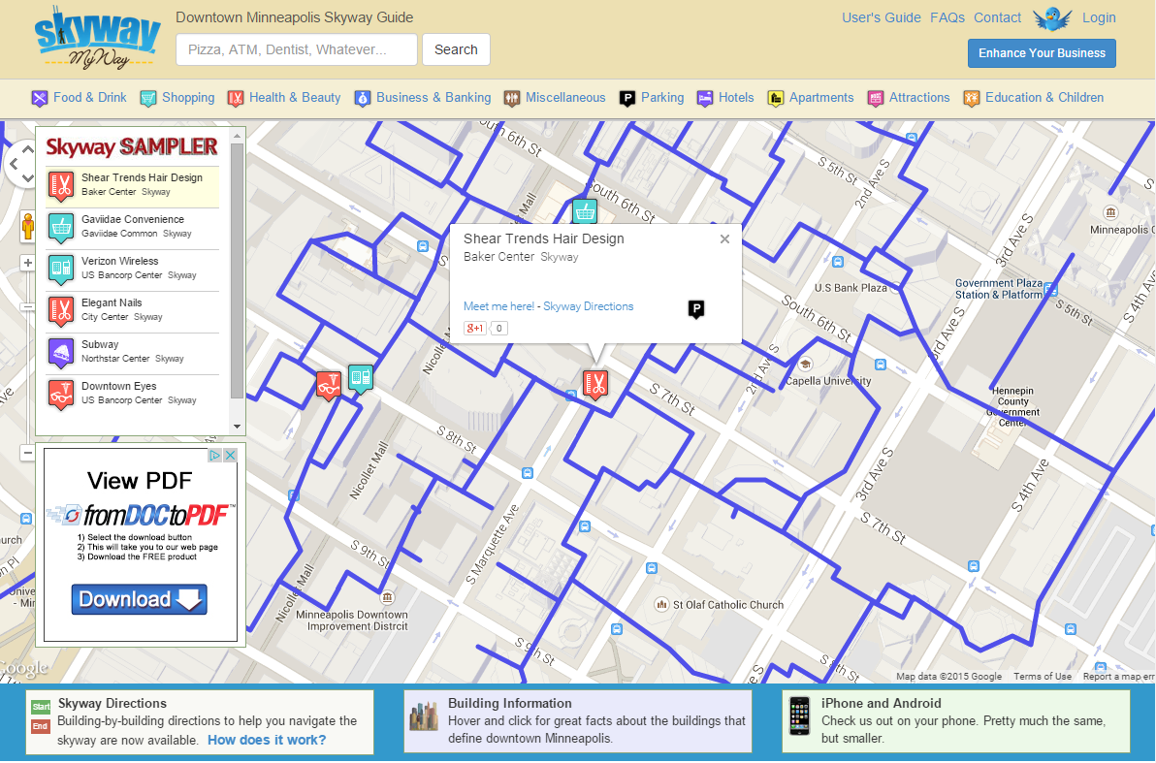
www.skywaymyway.com

Slide 16
What I’d like to do this morning
Try to convince you
that usability testing is one of the best, most cost-and time-effective ways to build better “stuff”
that it’s much easier than you think, and
that you can–and should–be doing it as part of every project
And show you
how to keep it simple enough so you’ll actually do it

Slide 17
45 action-packed minutes
Why do usability testing?
A demo test
A few testing “maxims”
Maybe even a question or two

Slide 18
First, help me calibrate
Read it?
Read it?

Slide 19
Another show of hands
Your experience with usability testing
Have conducted tests (facilitator)?
Have observed tests?
Have read usability test reports?
Your/your group’s use of testing
Never?
Right before (or right after) product ships?
Routinely (several times during each project)?

Slide 20
Essay question
If you don’t routinely do usability testing, why not?
What are the biggest obstacles to doing testing?

Slide 21
So…
Why usability testing?
Fifteen years ago, I realized something

Slide 22
© 2001 Steve Krug

Slide 23
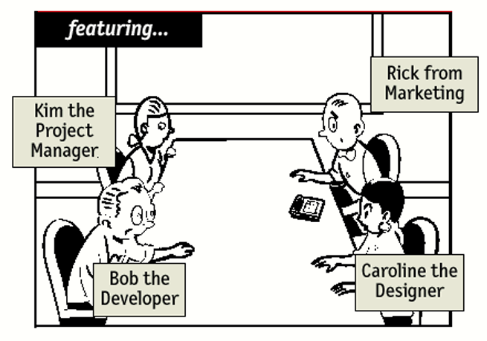

Slide 24
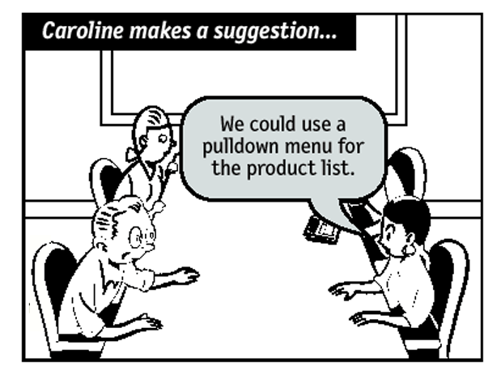

Slide 25
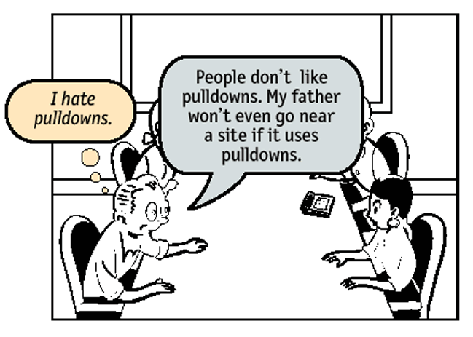

Slide 26
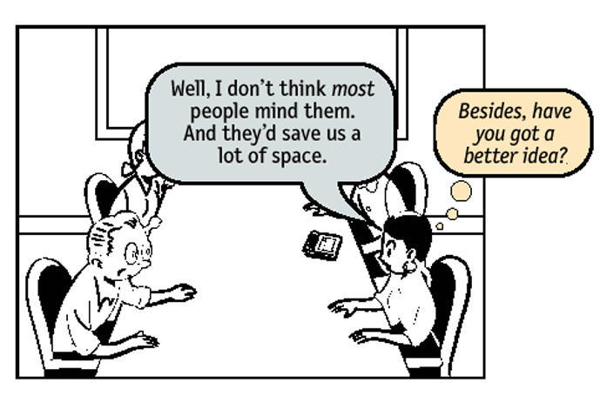

Slide 27
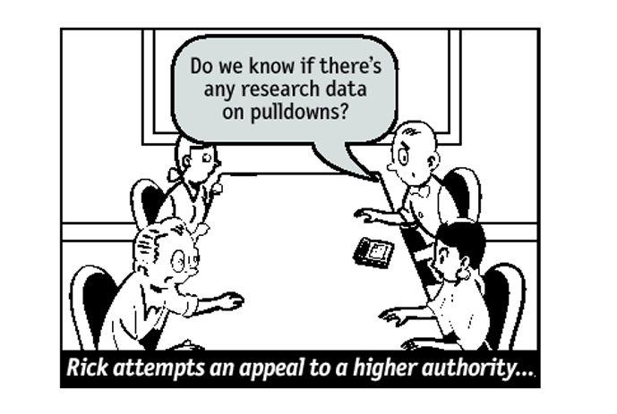

Slide 28
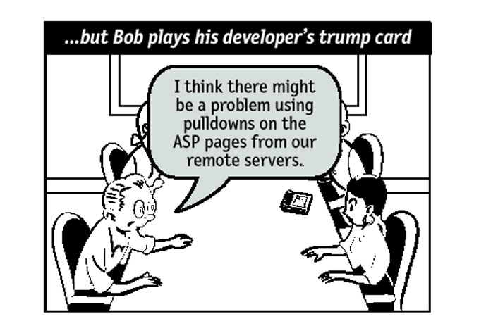

Slide 29
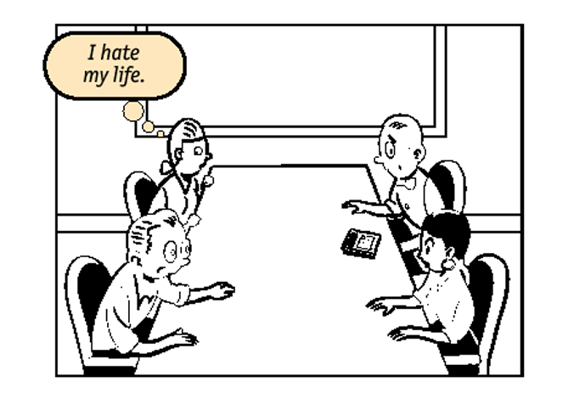

Slide 30
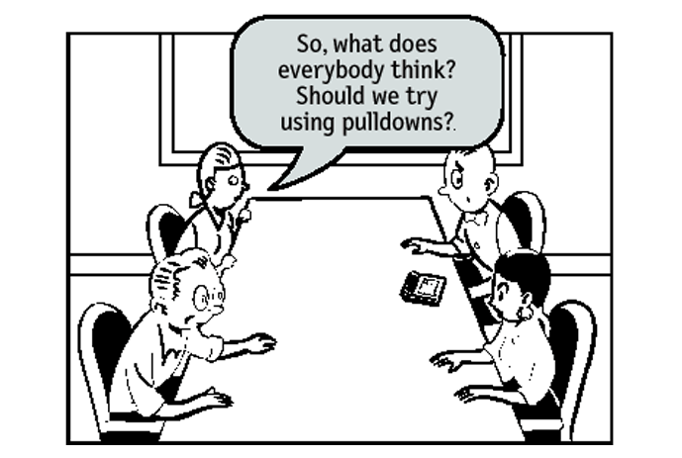

Slide 31
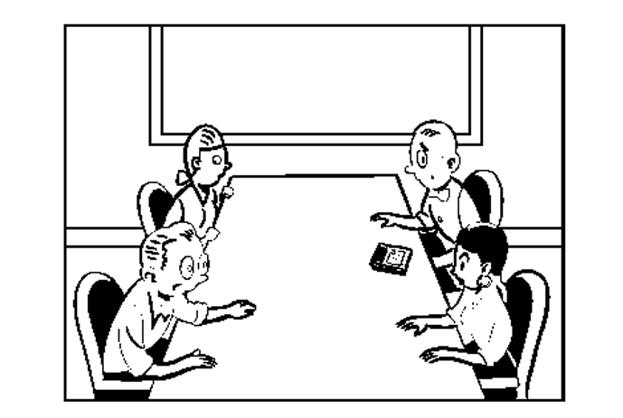

Slide 32
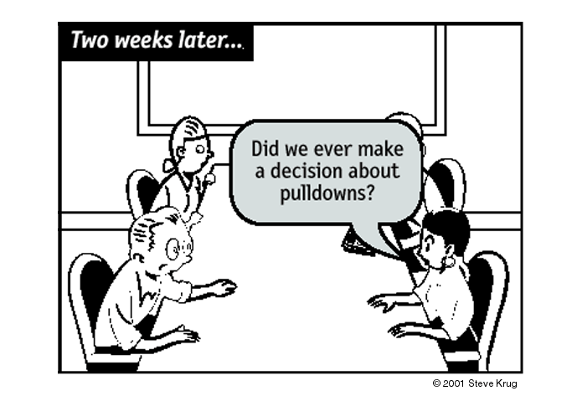

Slide 33
“My ideal home page,” as told by…

Slide 34
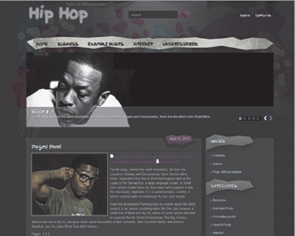
“My ideal home page,” as told by…

Slide 35
What is a usability test?
Watching people try to use what you create
…while thinking out loud

Slide 36
Do-it-yourself usability testing
Almost anyone can do it
It doesn’t have to take a lot of time or effort
It always makes the user experience better

Slide 37
A brave volunteer?
We’ll try an actual test
It’s painless
It’s brief
You’ll get a round of applause when we’re done
Qualifying criteria:
Have used a Web browser
English-speaking adult
Have not used SkywayMyWay.com
The rest of you are now observers
Pretend you’re sitting in a room down the hall
Jot down the top 1 or 2 problems you observe

Slide 38
See? Nothing to it
All you really do is
Keep the participant thinking aloud
Keep the participant “on-task”
The only tricky part is keeping yourself out of it
Resisting the urge to offer help
Resisting the urge to lead the witness

Slide 39
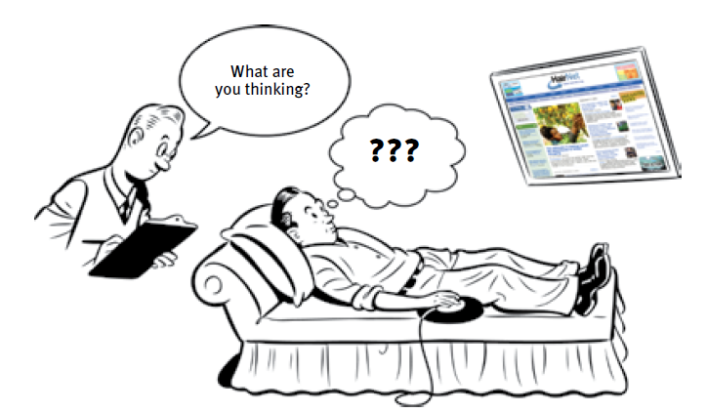
It’s a lot like therapy

Slide 40
When this happens: | Say this:
You’re not absolutely sure you know what the user is thinking (see below). | “What are you thinking?” “What are you looking at?” (for variety) “What are you doing now?” (e.g., if you think they’re being silent because they’re reading)
Something happens that seems to surprise them. For instance, they click on a link and go “Oh” when the new page appears. | “Is that what you expected to happen?”
They’re trying to get you to give them a clue. (“Should I use the ___?”) | “What would you do if you were at home?” “What would you do if I wasn't here?”
The participant makes a comment, and you’re not sure what triggered it. | “Was there something in particular that made you think that?”
The participant suggests concern that he’s not giving you what you need. | “No, this is very helpful.” “This is exactly what we need.”
The participant asks you to explain how something is supposed to work. (“Do these support requests get answered right away?”) | “I can’t answer that right now, because we need to know what you would do when you don’t have somebody around to answer questions for you. But if you still want to know when we’re done, I’ll be glad to answer it then.”
The participant seems to have wandered away from the task. | “What are you trying to do now?”

Slide 41
Afterwards comes the debriefing
What were the most serious problems?
Observed problems

Slide 42
DIY usability testing (nutshell version)
Three users
You’ll find more problems than you can fix
No lab or mirrors
Set up a monitor in another room so the whole team can watch
Record with Camtasia or another screen recorder
No stats, no exit questions, no faux validity
No big honkin’ report
Debrief over lunch

Slide 43
The maxims
Six of them, from Rocket Surgery Made Easy

Slide 44
1
Start earlier than you think makes sense.

Slide 45
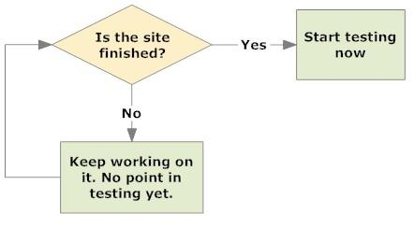
Incorrect thinking

Slide 46
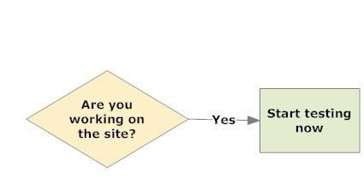
Correct thinking

Slide 47
You can test…
Your existing site or app if redesigning
Competitors’ sites or apps 
A sketch on a napkin
Wireframes
Prototypes (e.g. Balsamic, Axure)
Comps
Portions that have been built
Alpha, beta, etc.

Slide 48
2
A morning a month, that’s all we ask.

Slide 49
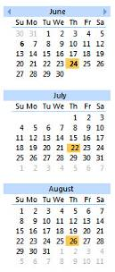
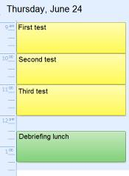

Slide 50
3
Recruit loosely and grade on a curve.

Slide 51
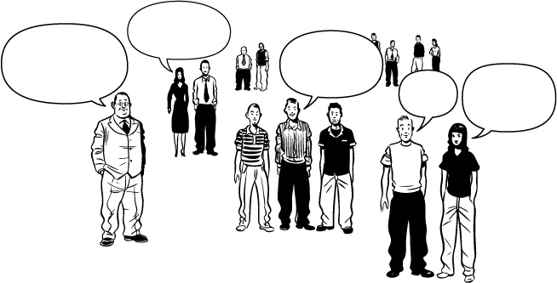
Representative users!
Naturally, we need to test people who are just like our target audience.
… people who actually use our site.
Real users!
… people who are a lot like our users.

Slide 53
4
Make it a spectator sport.

Slide 54
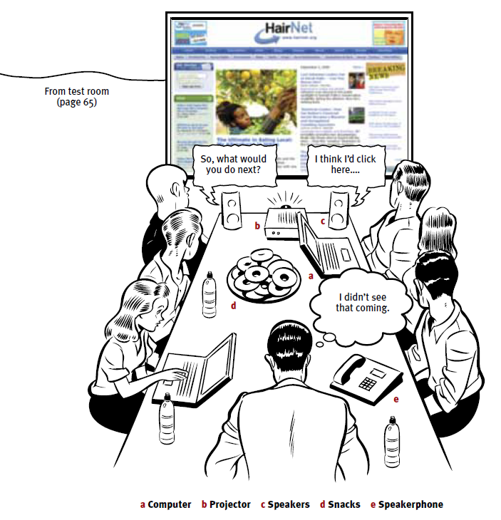

Slide 55
5
Focus ruthlessly on a small number of the most important problems.

Slide 56
The problem is, testing works
If you’ve done any testing, you know it uncovers lots of problems quickly
But I finally realized this is part of the problem
It’s very easy to find more problems than you can have the resources to fix

Slide 57
Problems you can find with just a few test participants
Problems you have the resources to fix

Slide 58
The lure of the low-hanging fruit
It’s easy to get seduced into fixing the easier problems first
As a result, the most serious usability problems often remain for a long time
The solution is to focus ruthlessly on the most serious problems first

Slide 59
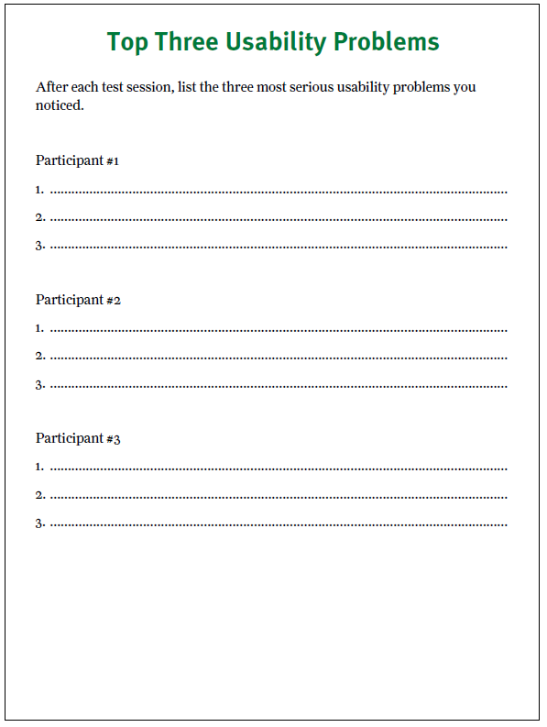

Slide 60
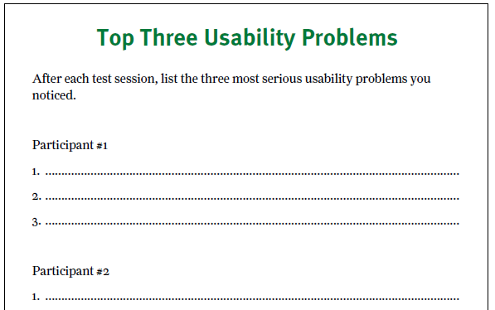

Slide 61
6
When fixing problems, always do the least you can do™.

Slide 62
Tweak, don’t redesign
When fixing usability problems, your motto should be:
What’s the smallest change we can make that we think might solve the observed problem?
Think tweak instead of perfect, complete solution

Slide 63
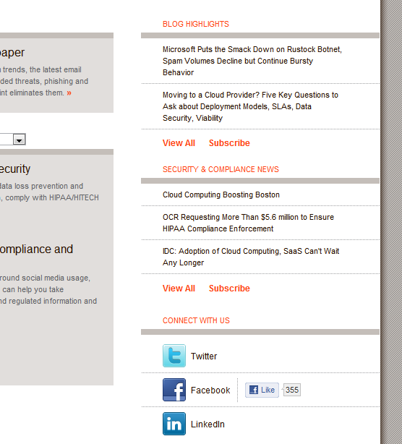

Slide 64
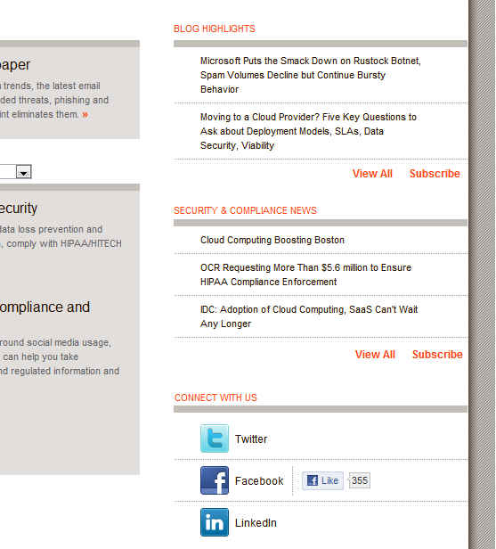

Slide 65
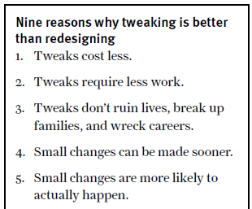

Slide 66
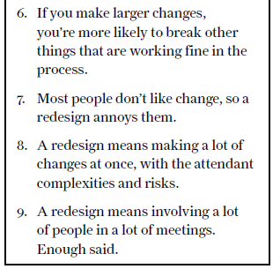

Slide 67
A great tip

Slide 68
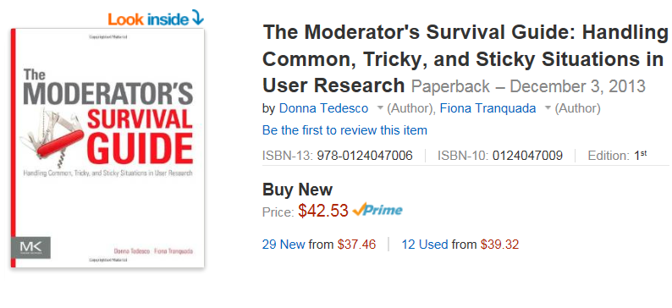
And another one…

Slide 69
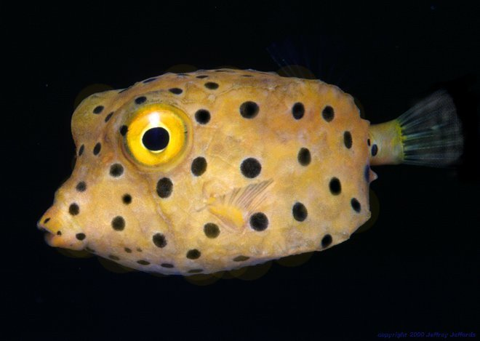
Photo © Jeff Jeffords www.divegallery.com

Slide 70
Thanks for all the fish
Send any questions, feedback, gripes to
skrug@sensible.com
or
@skrug
Or visit scenic
www.sensible.com

Slide 71
© 2015 Steve Krug

